Slide 1
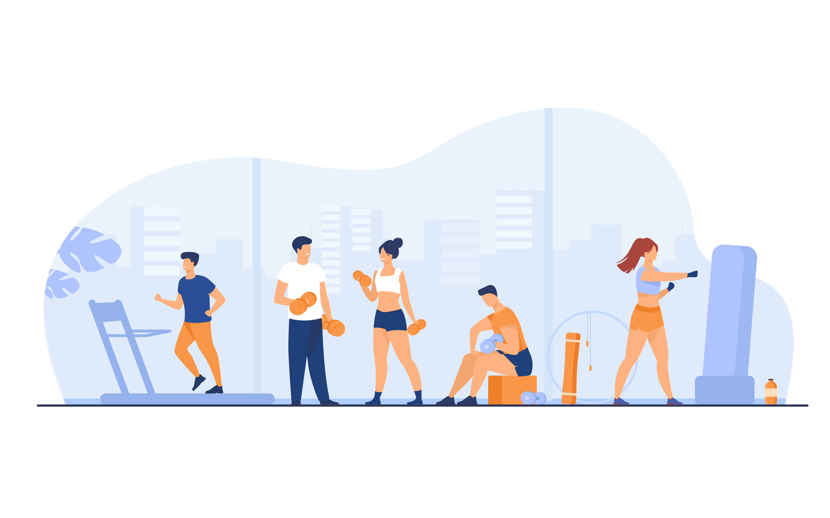
iOS APPLICATION
DEVELOPMENT
Final Project
My Fitness iOS Mobile Application
NIBM Index : COBSCCOMP211P-003
Coventry Index : 11664651
Notes:
Good Afternonn, sir
I’m a T.S. Wanniarachchi and My Index Is 21.1 - 003
I created My Fitness iOS mobile application for our iOS Application Development.

Slide 2
Introduction
Exercise is essential for maintaining a healthy lifestyle. Also maintaining a proper BMI level and exercising the body properly can lead to a healthy lifestyle and a healthy body. By accessing this iOS mobile app, people can access workout plans based on the data they provide and can customize it if they want. Apart from that we can track our exercise progress.

Slide 3
Development
Technical Tools Used
Node.js Express Framework RESTful APIs
MongoDB Cloud Database
Render Hosting Service
GitHub
Postman Software
VMware Workstation Pro
X code 14.1 (iOS 12.6.1)
Notes:
Development
The following technical tools were used to create this iOS mobile application
Node.js Express Framework RESTful APIs
MongoDB Cloud Database
Render Hosting Service
Postman Software
VMware Workstation Pro
X code 14.1 (iOS 12.6.1)

Slide 4
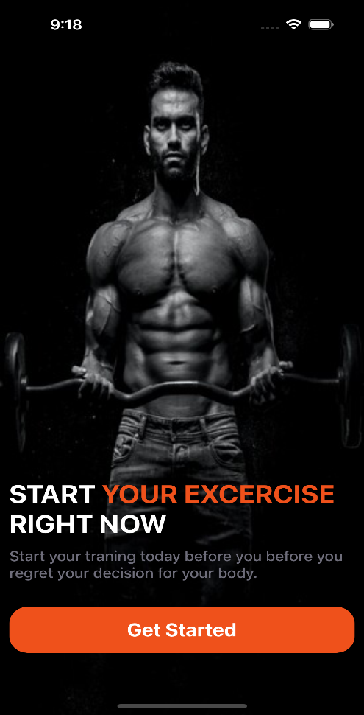
Front-End Development
Welcome Page
When the user accesses this iOS mobile application, the first thing user sees is this welcome screen. This screen acts as the initial interface and introduces the application.
Notes:
Front-End Development
Welcome Page
When the user accesses this iOS mobile application, the first thing user sees is this welcome screen. This screen acts as the initial interface and introduces the application.

Slide 5
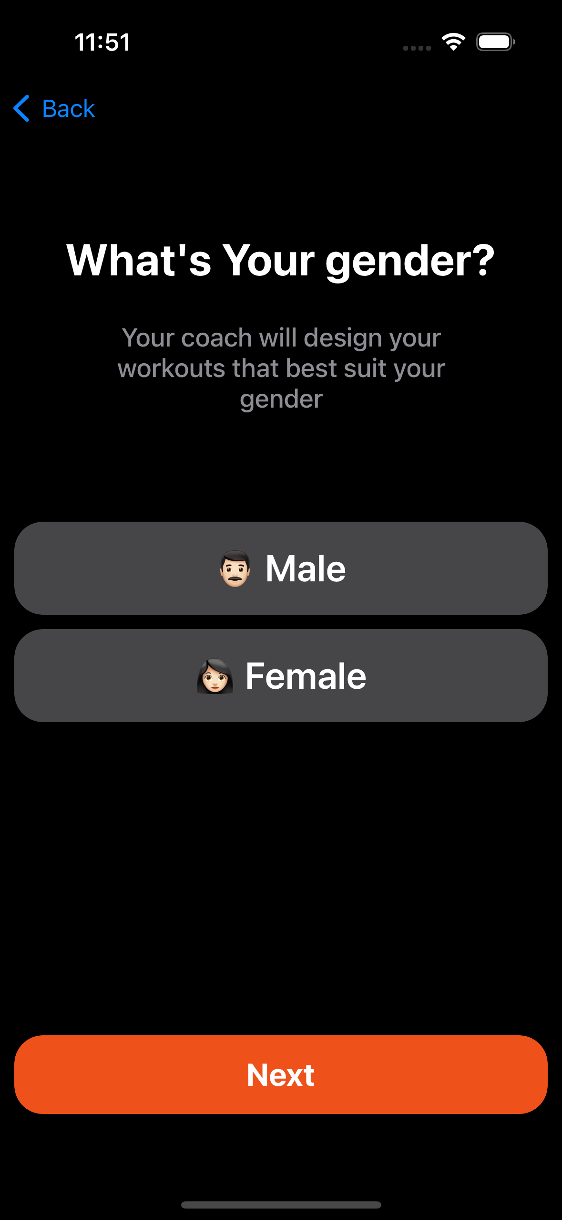
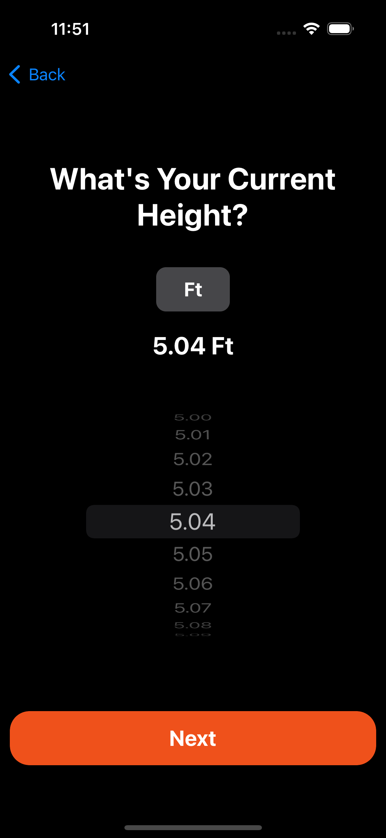
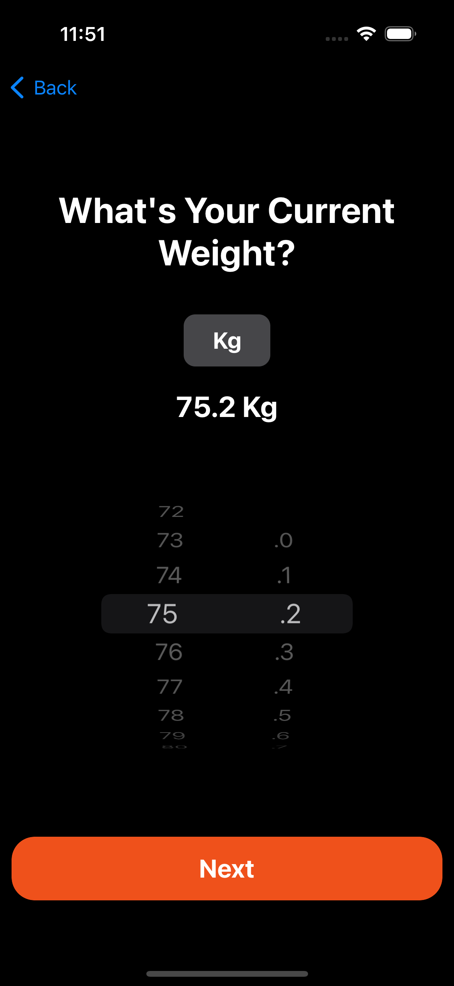
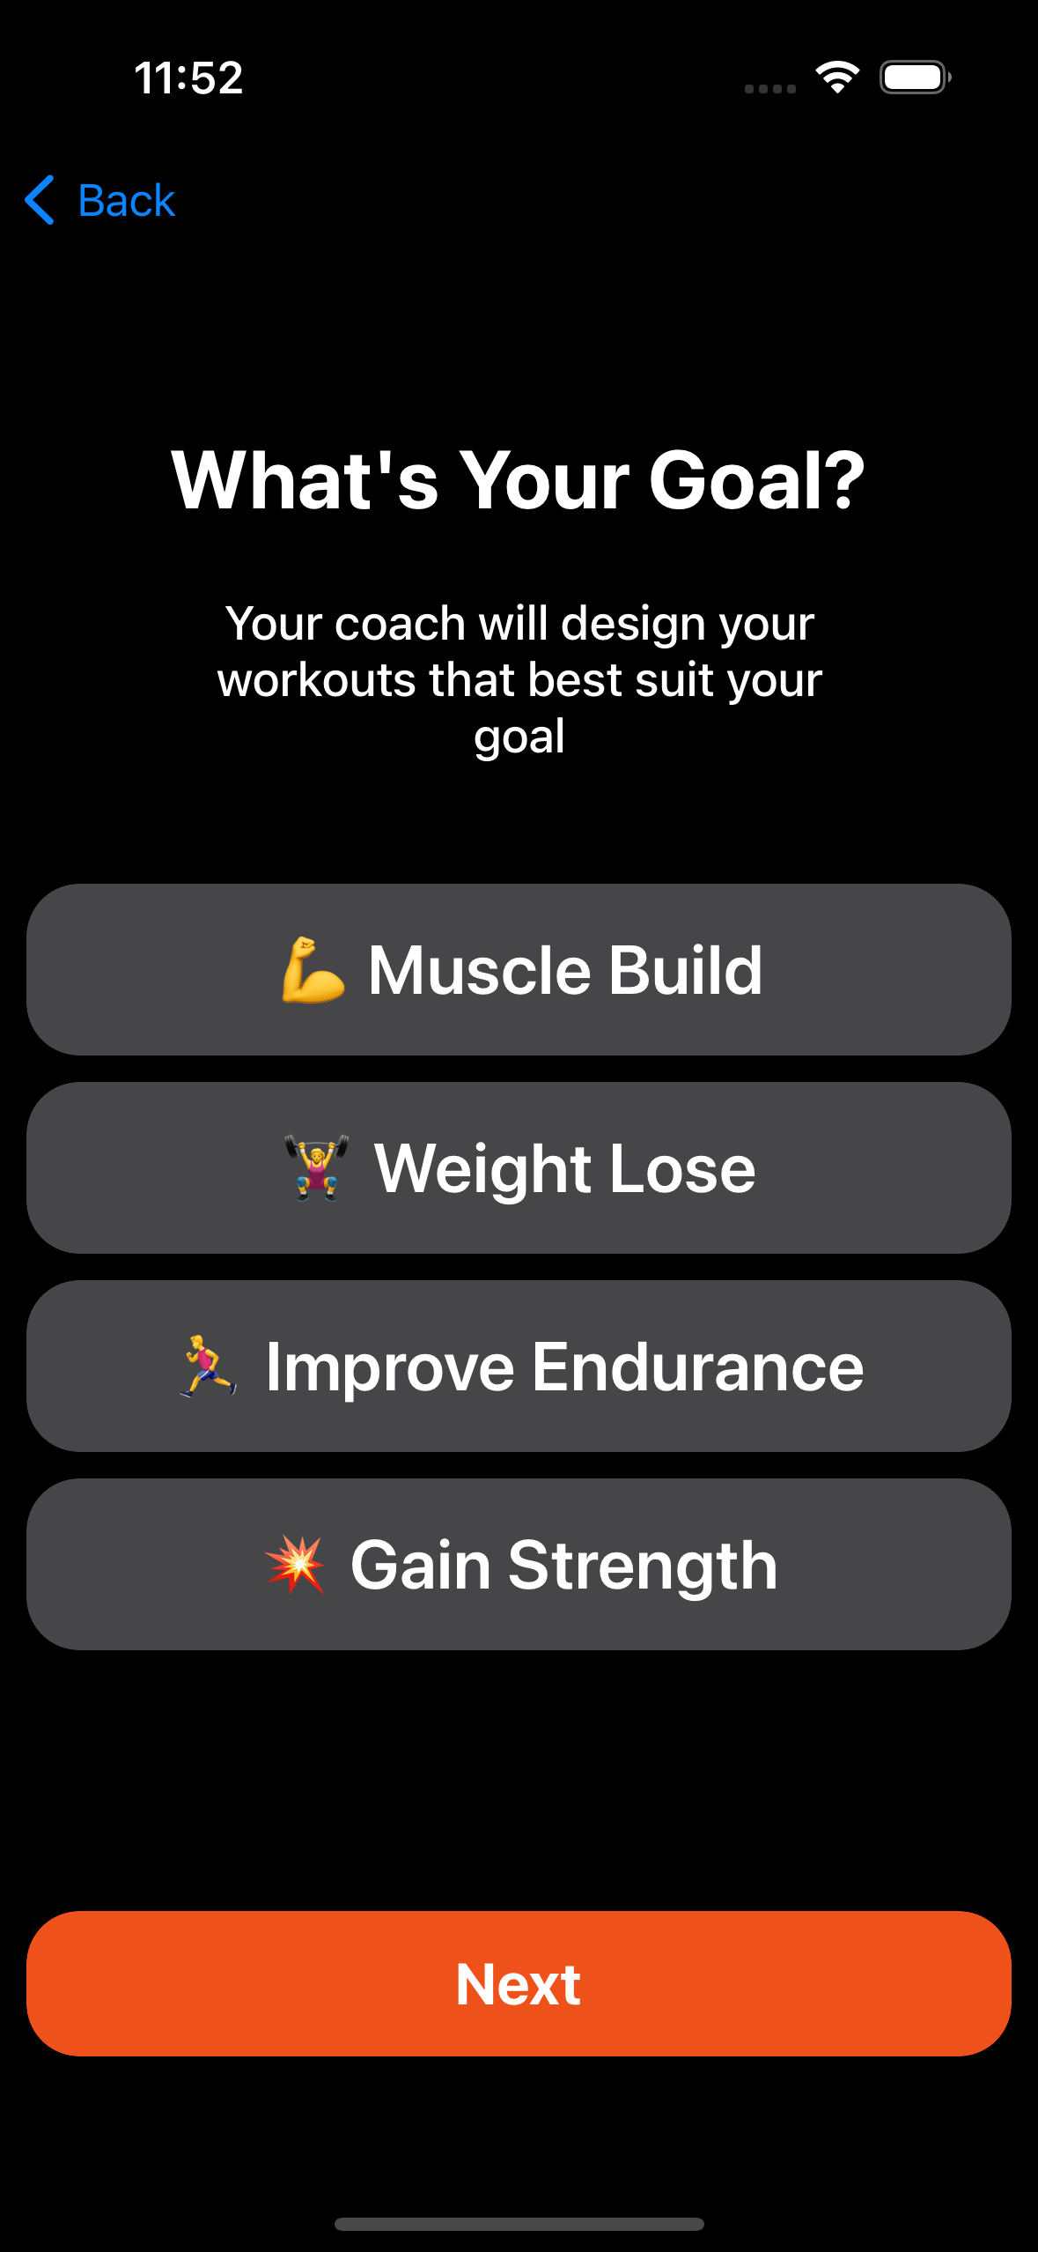
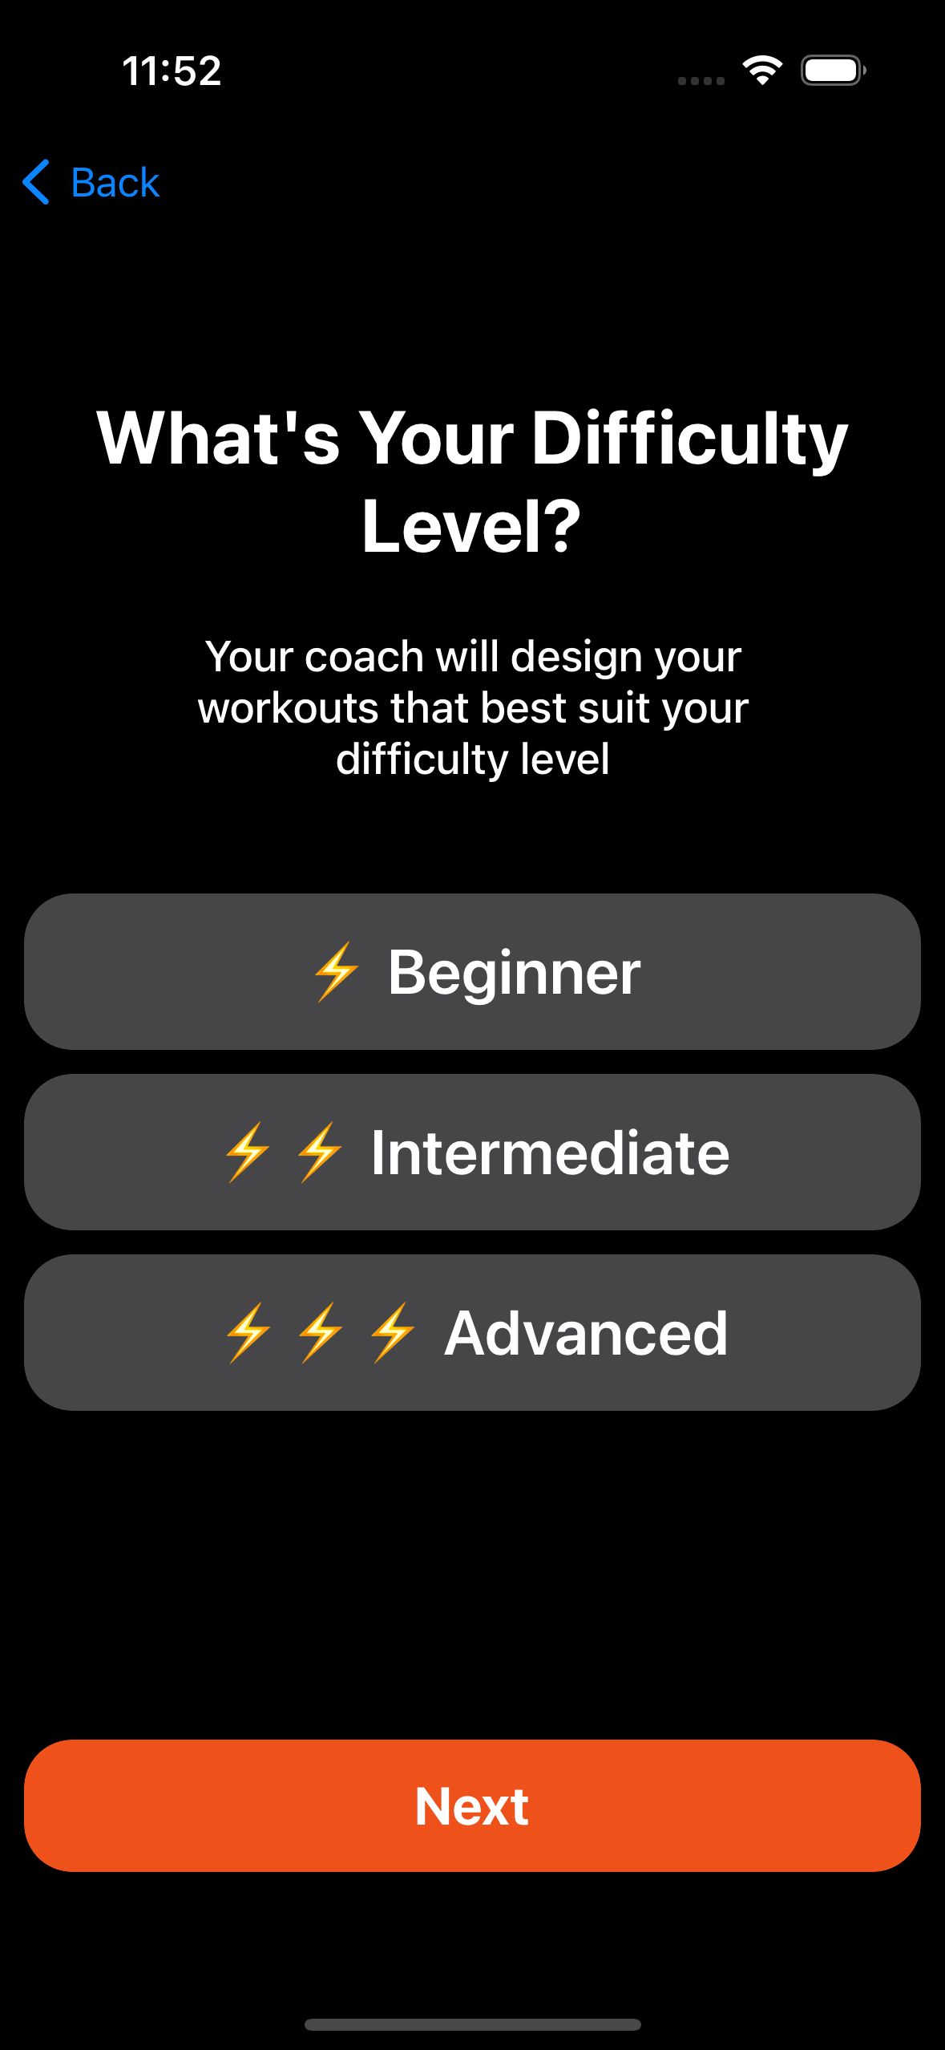
Front-End Development
User Details Capture Page
These Onboard Pages capture the user's Gender, Height, Weight, Fitness Goal, and difficulty level. Based on the data provided by the user, this fitness application calculates the BMI index and provides the fitness plans the user needs.
Notes:
User Details Capture Page
These Onboard Pages capture the user's Gender, Height, Weight, Fitness Goal, and difficulty level. Based on the data provided by the user, this fitness application calculates the BMI index and provides the fitness plans the user needs.

Slide 6
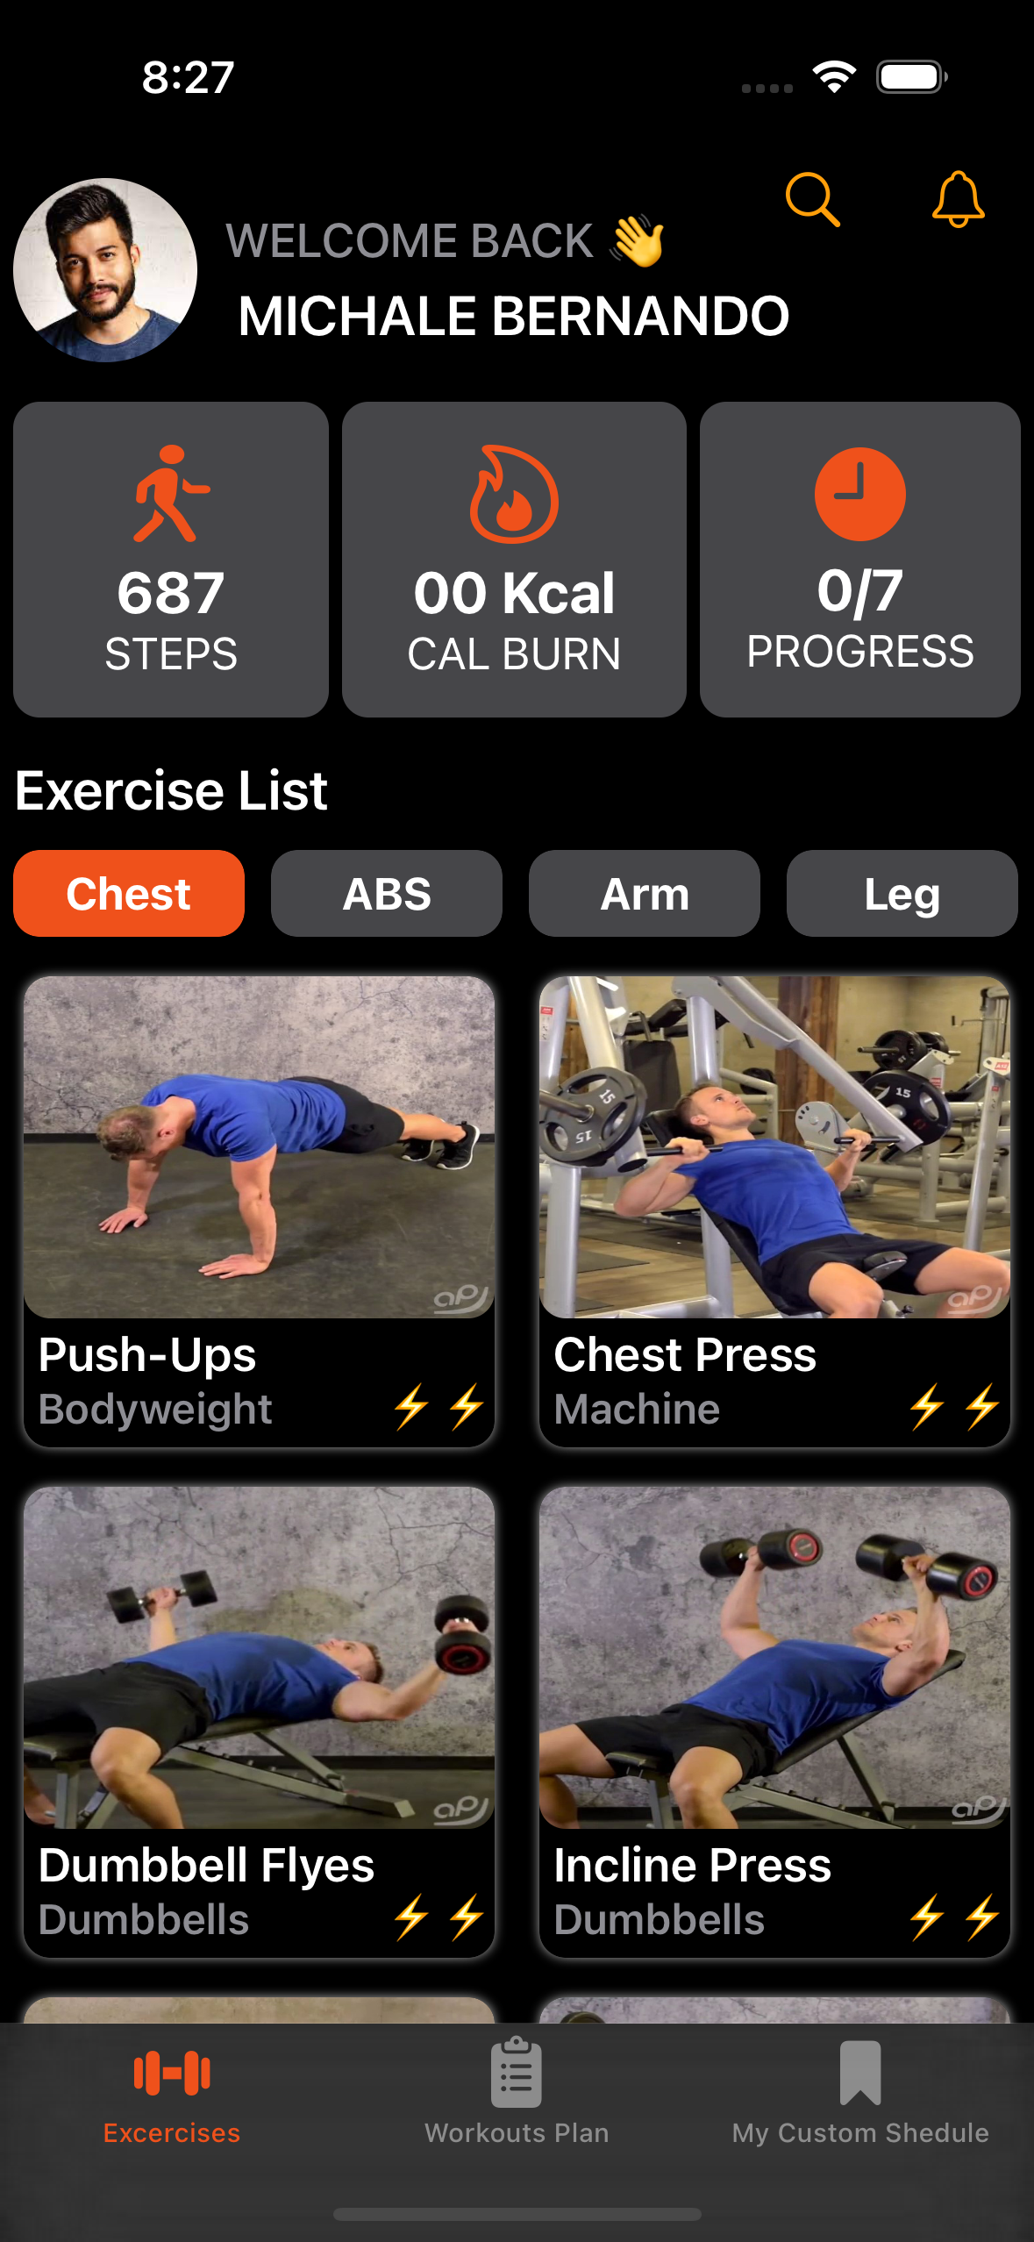
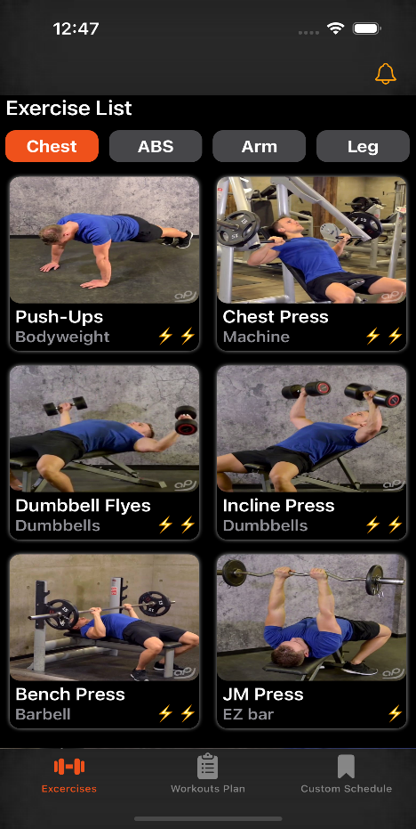
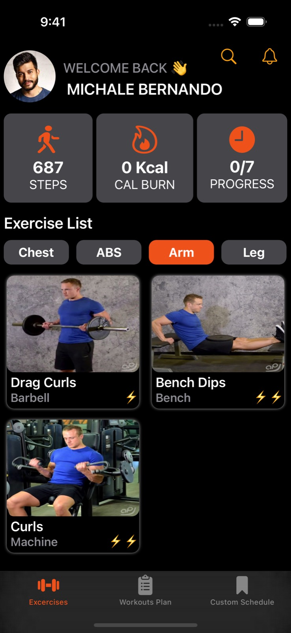
Front-End Development
Home Page
This is the homepage of this mobile application, which shows the exercise details.
Notes:
Home Page
This is the homepage of this mobile application, which shows the exercise details.
• Shows the details of the user logged into the application.
• Shows user's exercise history details.
• Shows a list of categorized exercises.

Slide 7
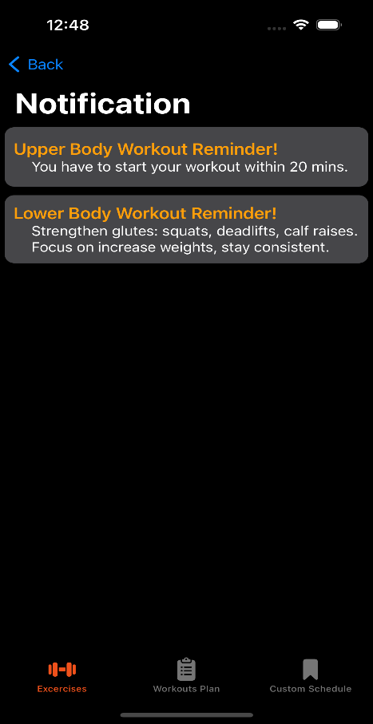
Front-End Development
Notification Page
The app can send reminders and notifications to complete their workouts based on the user's chosen schedule.
Notes:
Notification Page
The app can send reminders and notifications to complete their workouts based on the user's chosen schedule.

Slide 8
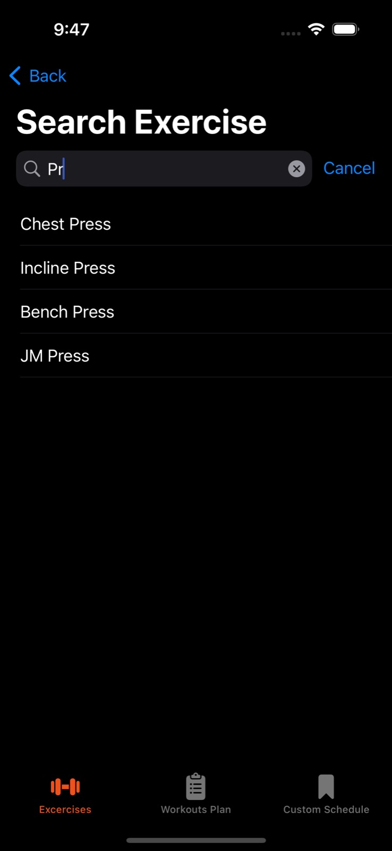
Front-End Development
Search Page
Through this page, users can search and view exercise details
Notes:
Search Page
Through this page, users can search and view exercise details.

Slide 9
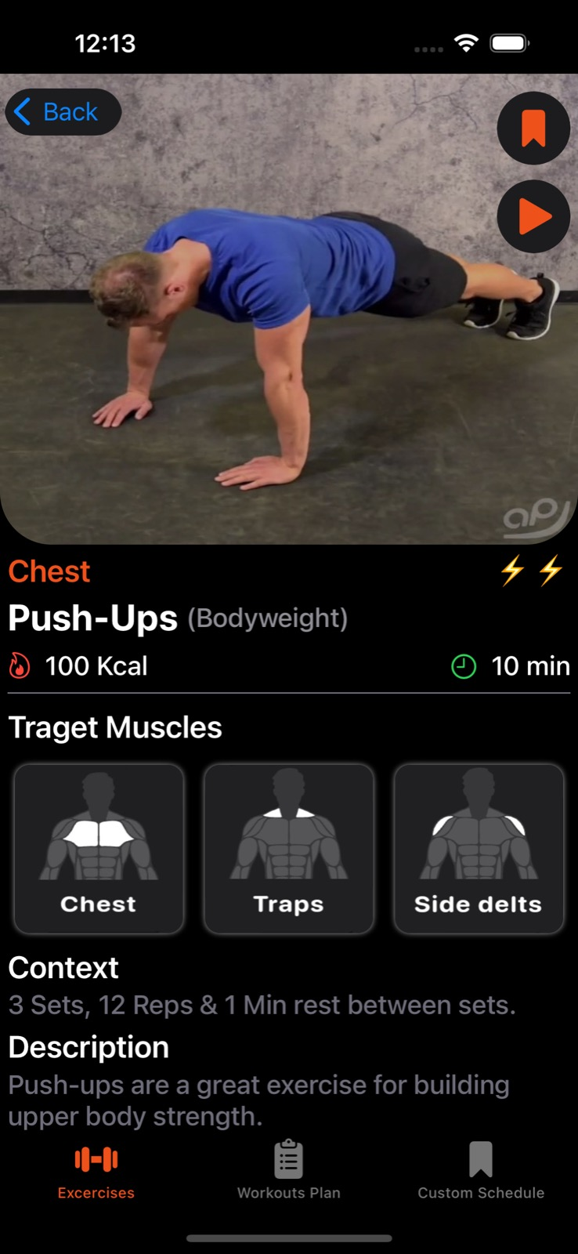
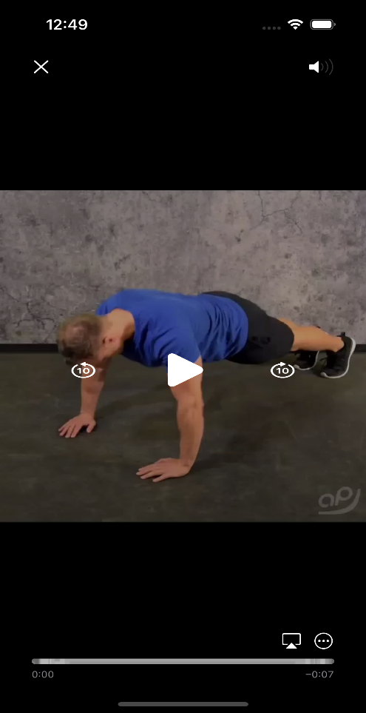
Front-End Development
Exercise Detail Page
Further details of an exercise are displayed on the Exercise Detail page.
Notes:
Exercise Detail Page
Further details of an exercise are displayed on the Exercise Detail page
• Shows the exercise name, category, set & rep count, time, and target muscles other details.
• Users can add exercise to custom schedule if desired.
• Users can watch videos related to the exercise.

Slide 10
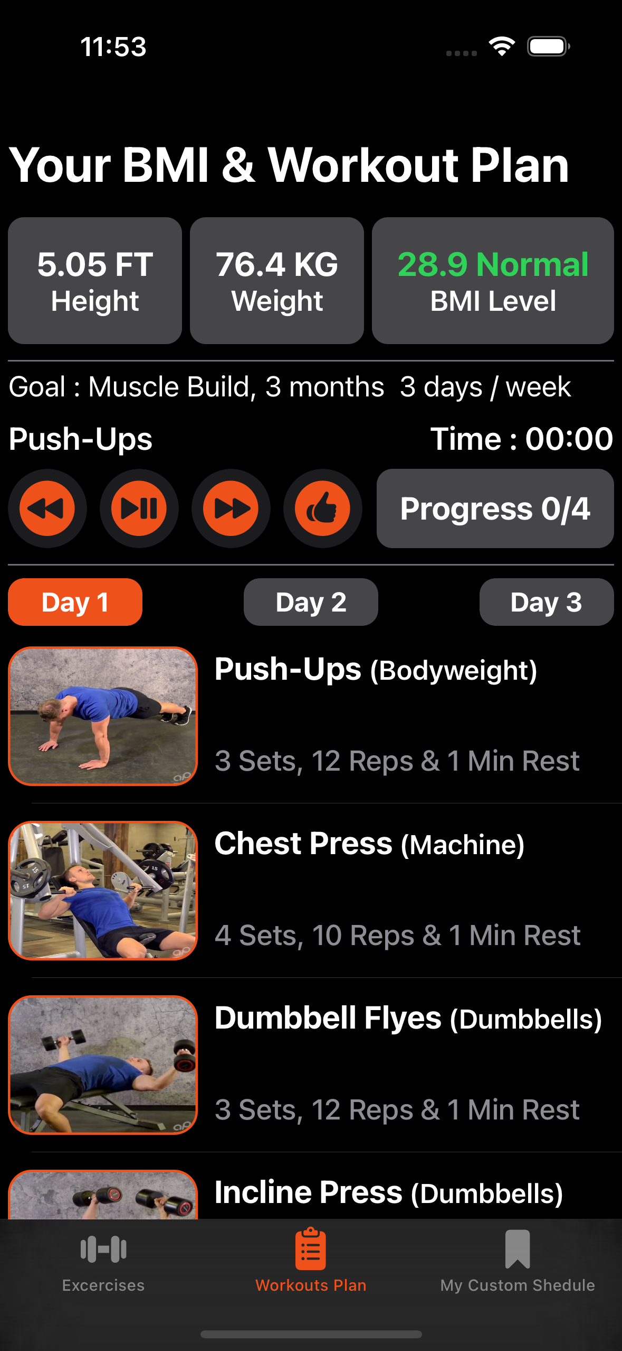
Front-End Development
Suggest Fitness Plans and BMI Calculation Page
This page calculates the BMI index based on the data entered by the user and suggests a fitness plan.
Notes:
Suggest Fitness Plans and BMI Calculation Page
This page calculates the BMI index based on the data entered by the user and suggests a fitness plan.
• Displays the user's height weight and BMI value.
• The workout plan that suits the user is displayed. It is three days for a week.

Slide 11
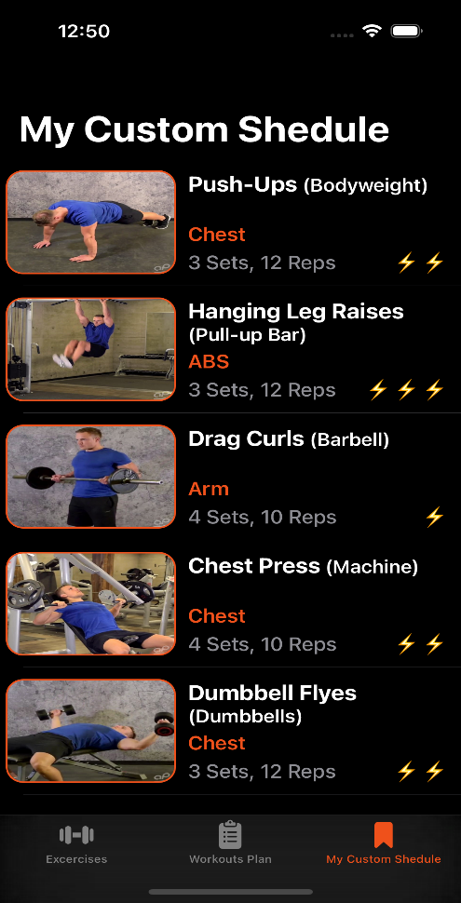
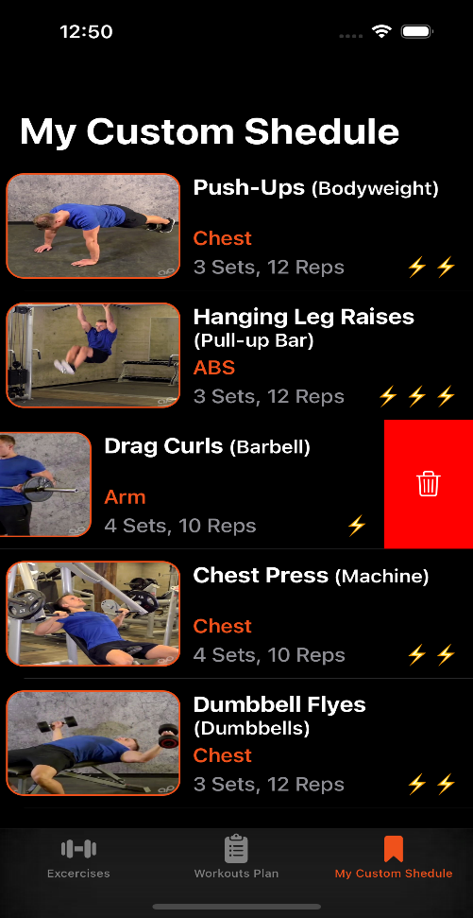
Front-End Development
View Custom Schedule Page
This page displays the exercises in the user's custom schedule are displayed.
Notes:
View Custom Schedule Page
This page displays the exercises in the user's custom schedule are displayed.
• The exercises that the user added from the exercise detail page.
• User can remove an exercise by swiping a table cell to the left in the exercise list.

Slide 12
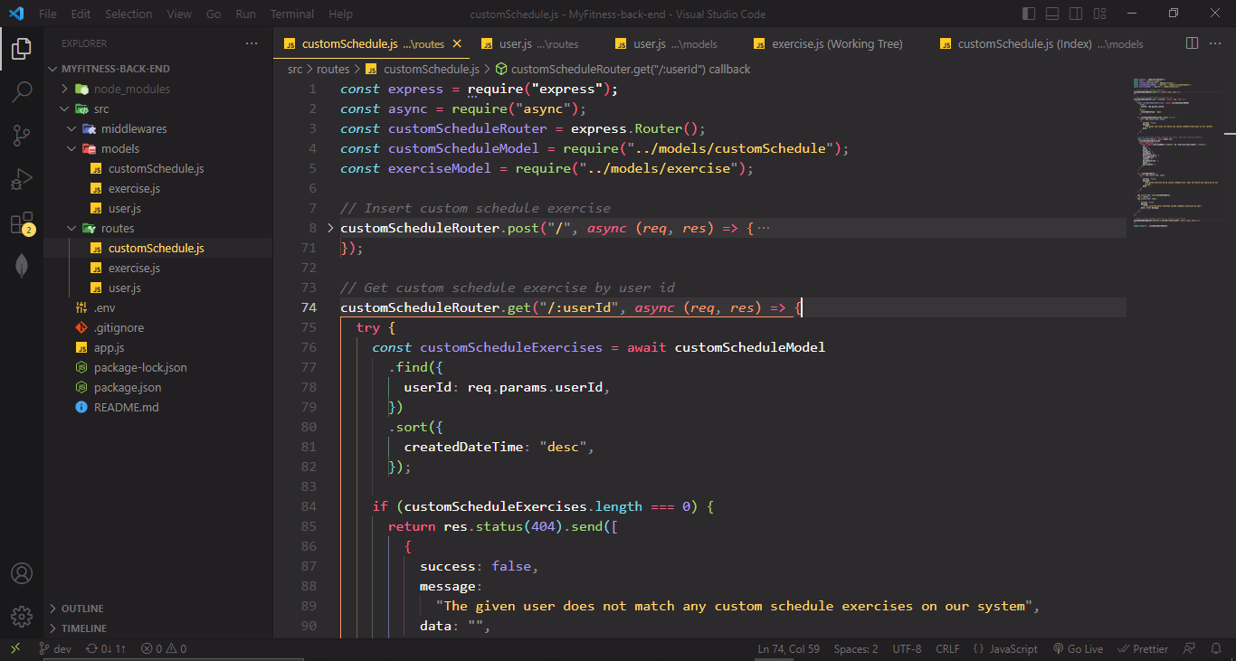
Back-End Development
Web API Project
The backend REST API project was developed using Node.js and the Express framework.
Notes:
Back-end Web API Project
The backend REST API project was developed using Node.js and the Express framework.
user, exercise and customSchedule Models and routes were created to handle user-related functionality, exercise management, and custom schedule features

Slide 13
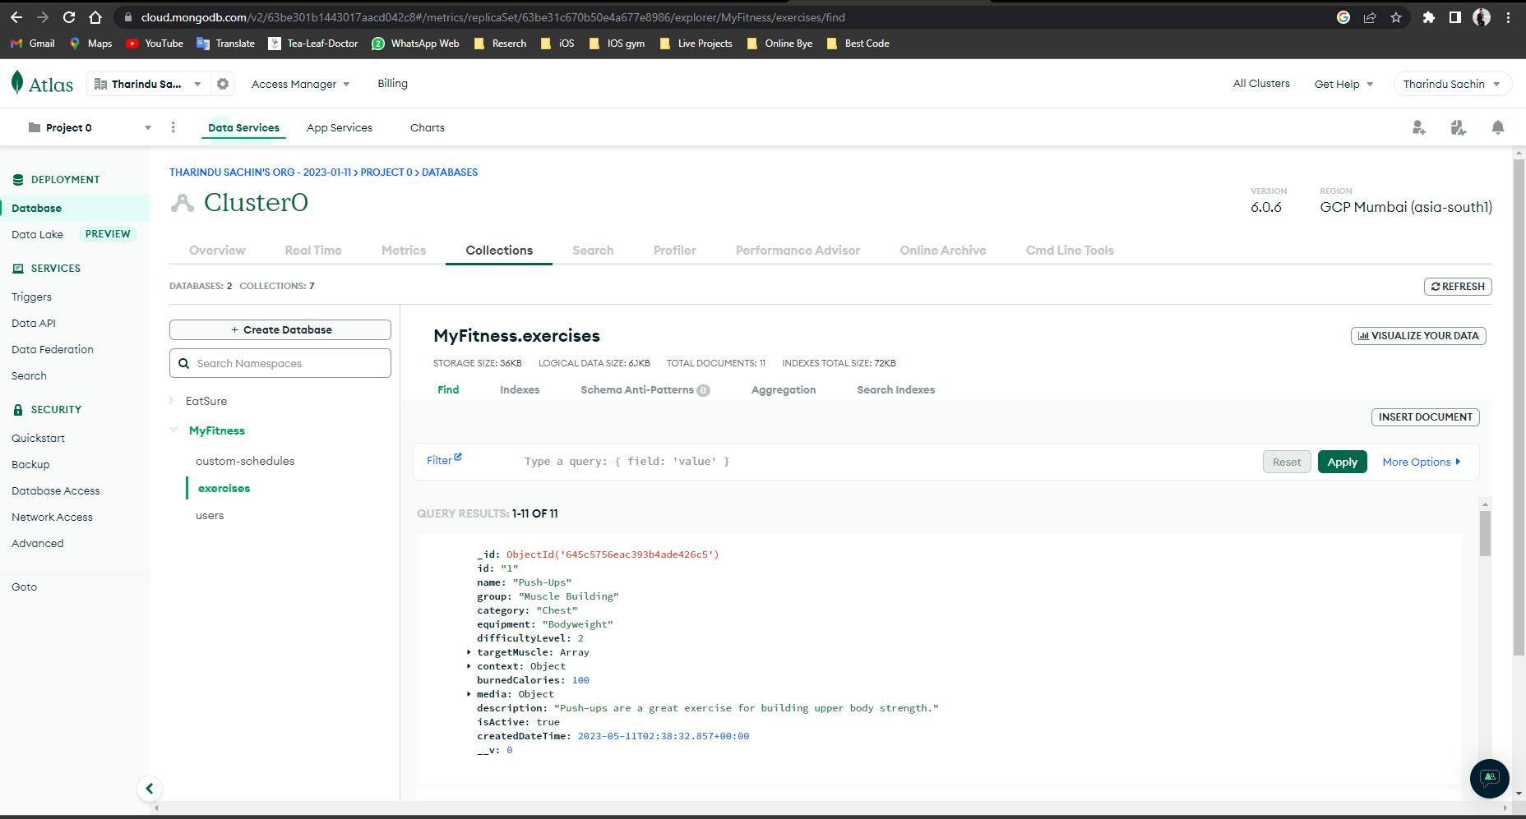
Back-End Development
Database
MongoDB Atlas Cloud Database
Notes:
Database
The project's backend database relied on MongoDB Atlas, providing a cloud-based solution for efficient data storage and retrieval.

Slide 14
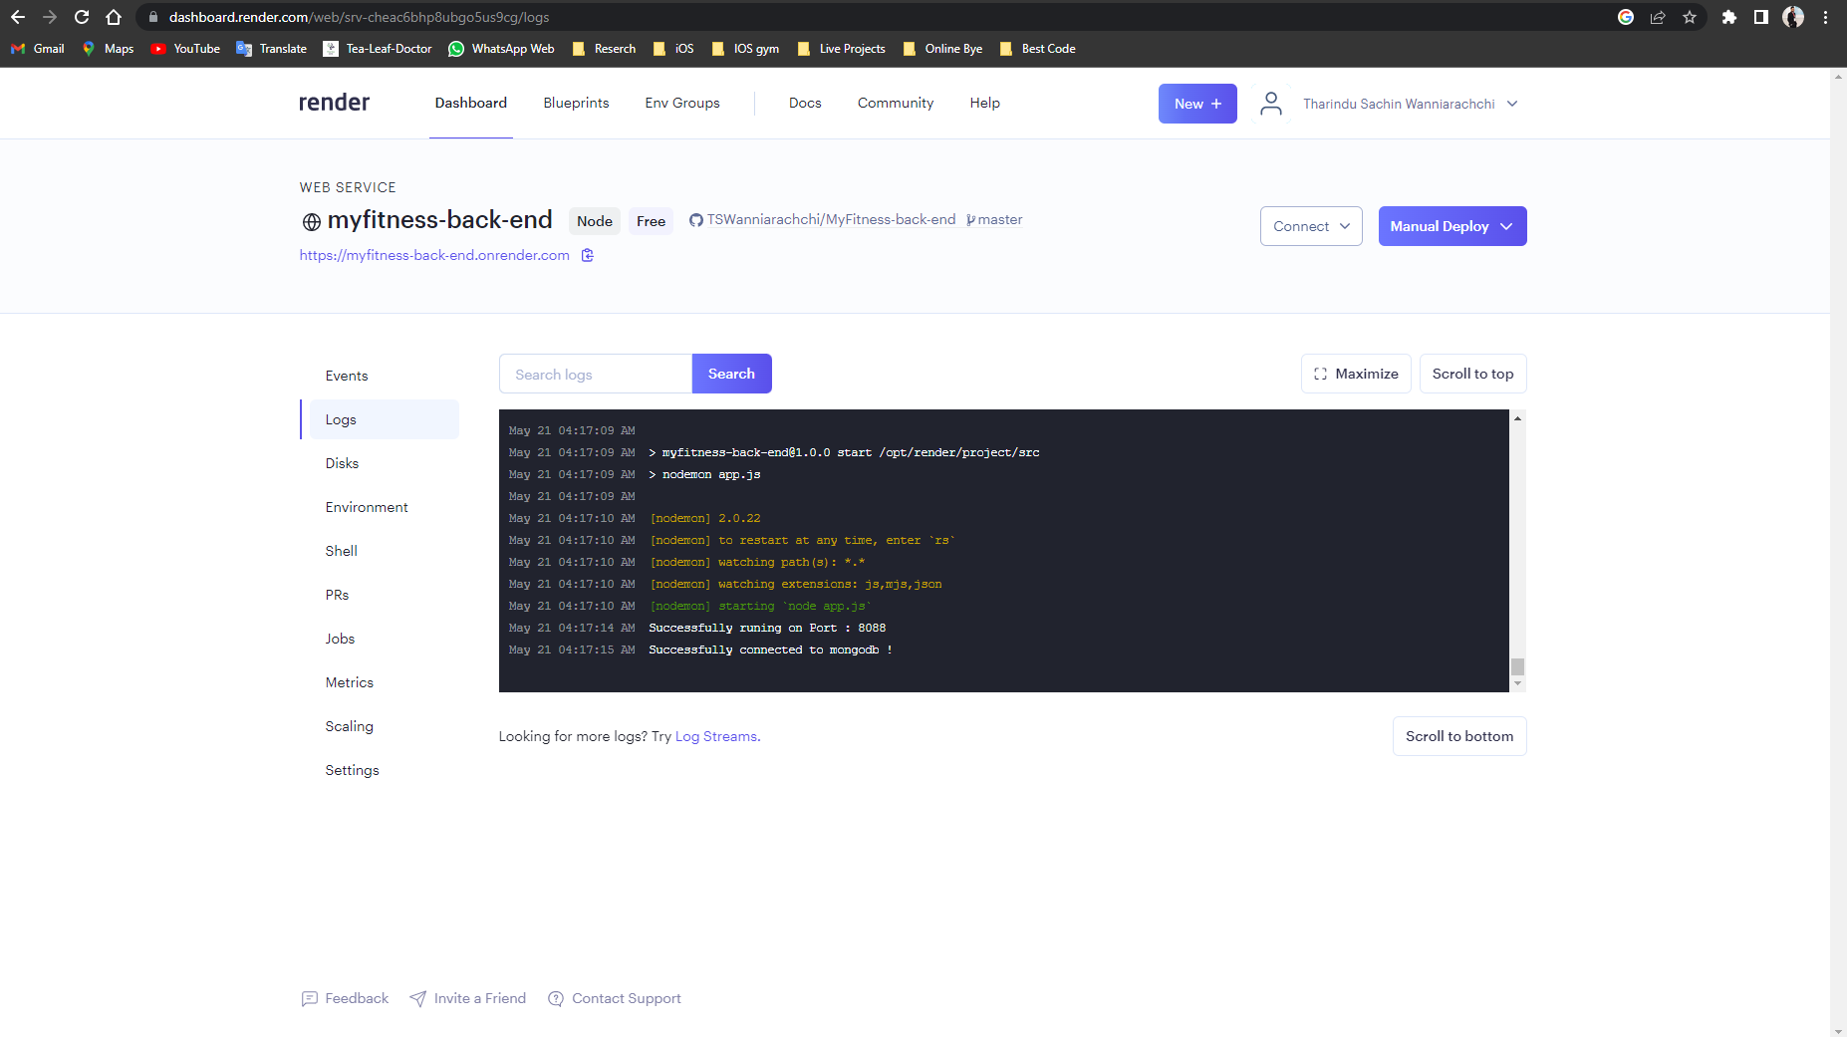
Back-End Development
Hosting Environment
The RESTful web API project was hosted on the Render platform
Notes:
Hosting Environment
The RESTful web API project was hosted on the Render platform

Slide 15
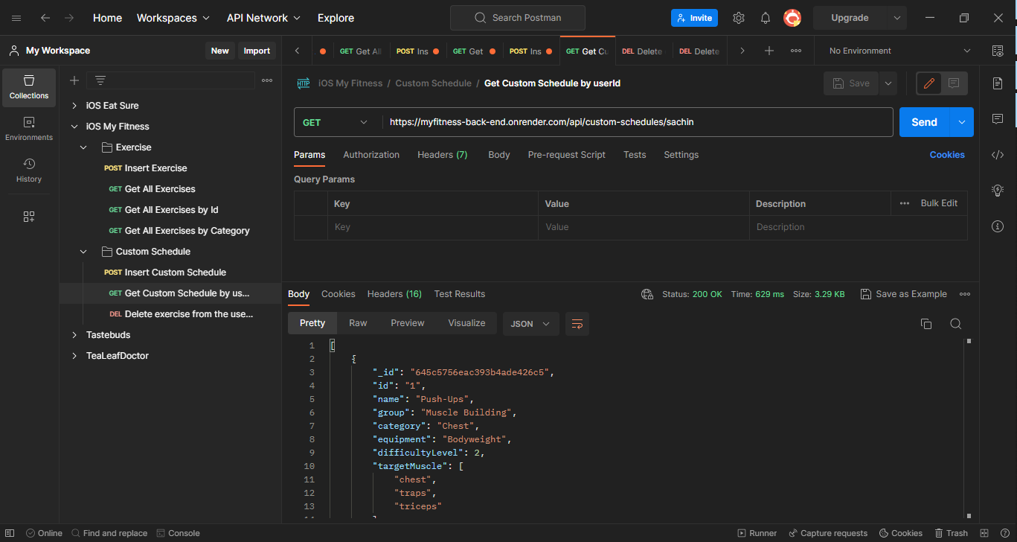
Back-End Development
Postman
Postman was utilized to validate and test the API requests
Notes:
Postman
Postman was utilized to validate and test the API requests

Slide 16
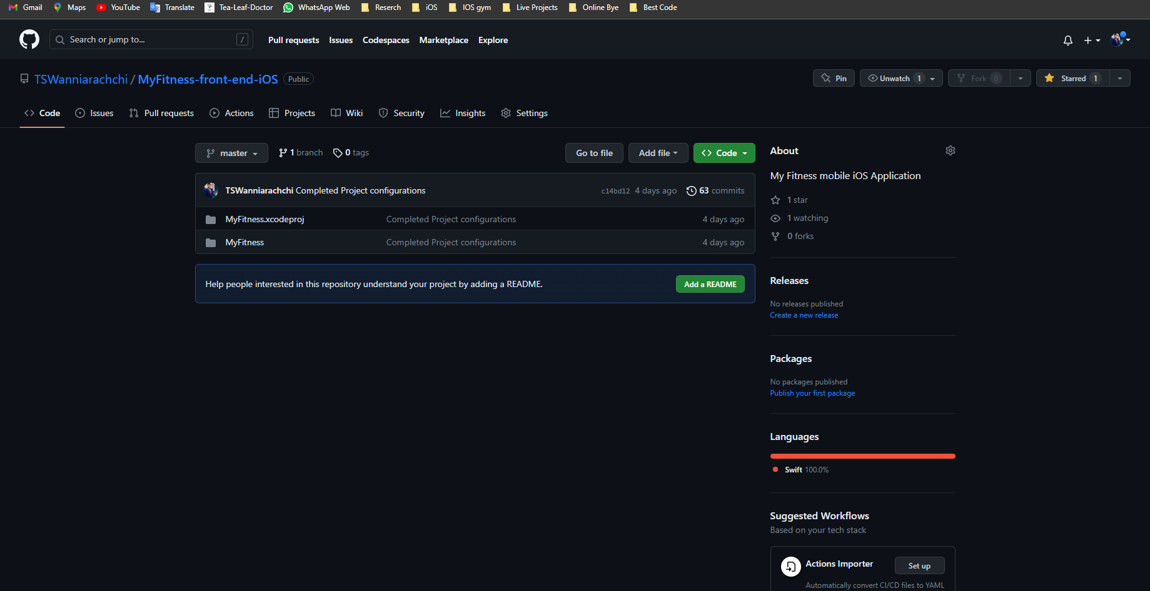
Back-End Development
Source Control
Used GitHub as a source control tool for web API project and iOS mobile application.
Notes:
Source Control
Used GitHub as a source control tool for web API project and iOS mobile application.

Slide 17
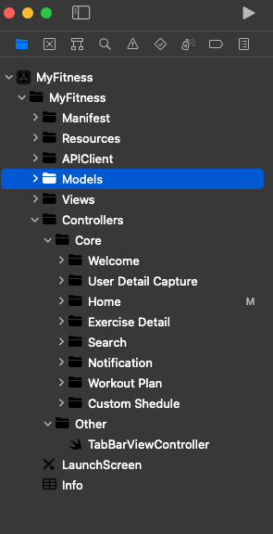
Using Best Practices
MVC Architecture
MVC architecture was used to create
this application.
Notes:
MVC Architecture
MVC architecture was used to create this application. It helps organize code properly by separating the view (user interface), models (database), and containing logic in controllers.

Slide 18
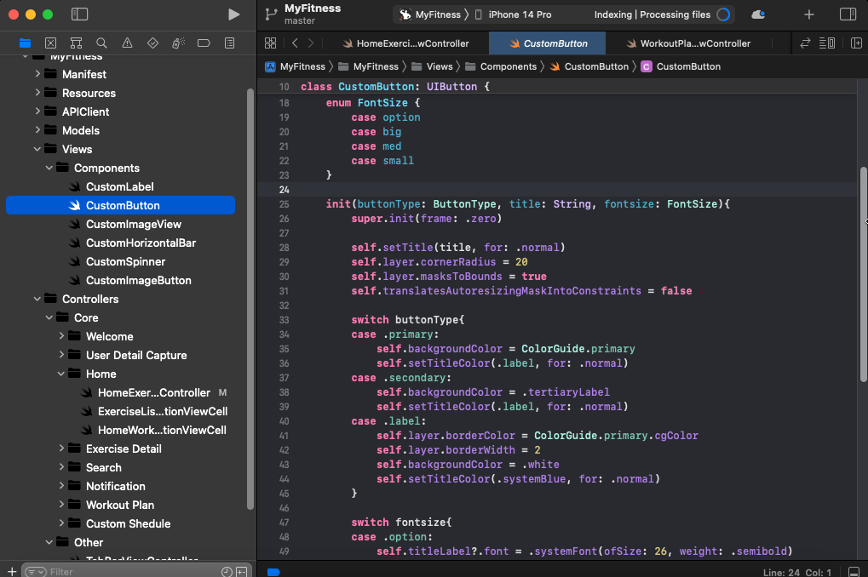
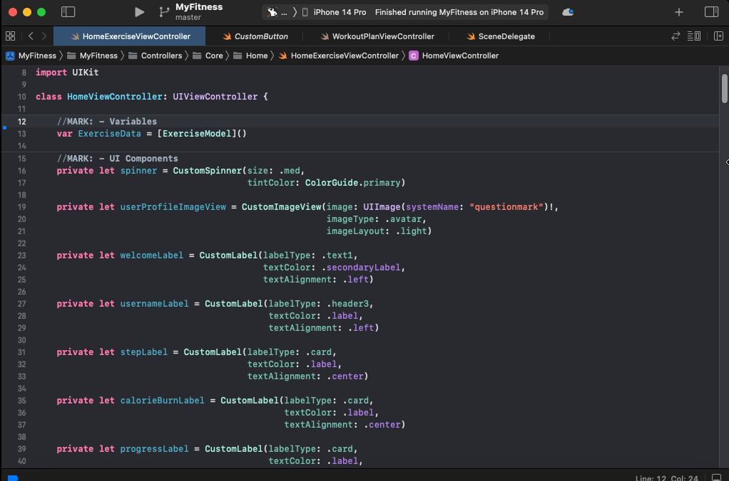
Using Best Practices
Reusable Custom UI Component
A reusable custom component was created and used during the design of UI. It made it easy to create a UI.
Below is the reusable UI Component and how it is used in a view controller.
Notes:
Reusable Custom UI Component
A reusable custom component was created and used during the design of UI. It made it easy to create a UI.
Below is the reusable UI Component and how it is used in a view controller.

Slide 19
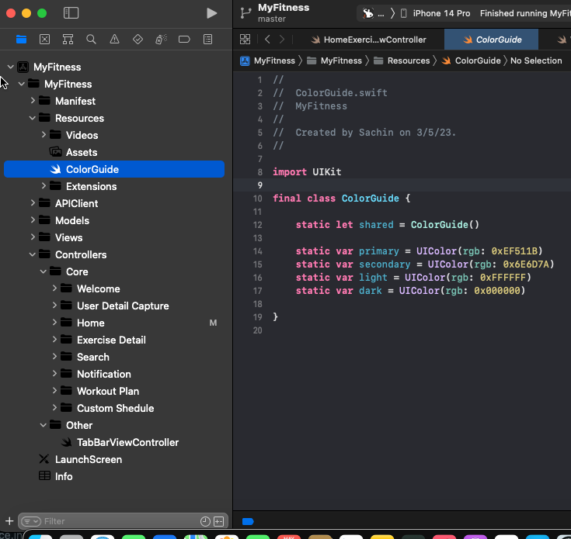
Using Best Practices
App Theme in Separate File
A separate file was maintained to store the theme color of this iOS mobile application..
Notes:
App Theme in Separate File
A separate file was maintained to store the theme color of this iOS mobile application..

Slide 20
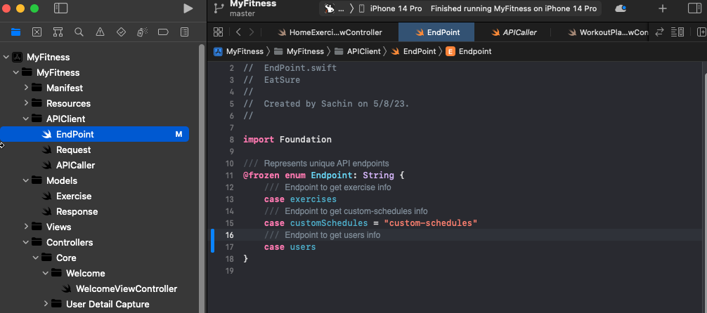
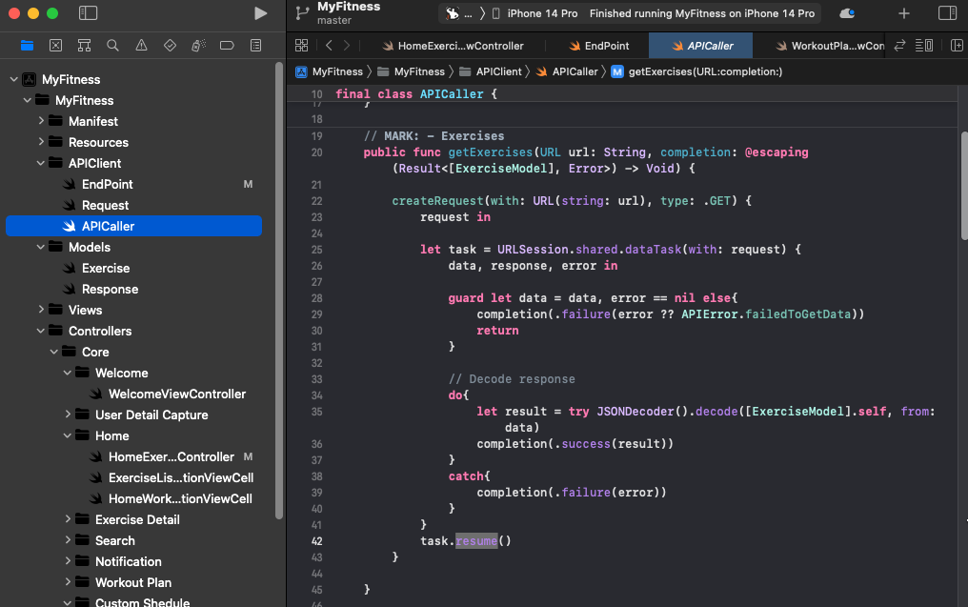
Using Best Practices
API services in Separate File
A Separate files were used to manage API services
Notes:
API services in Separate File
A Separate files were used to manage API services

Slide 21
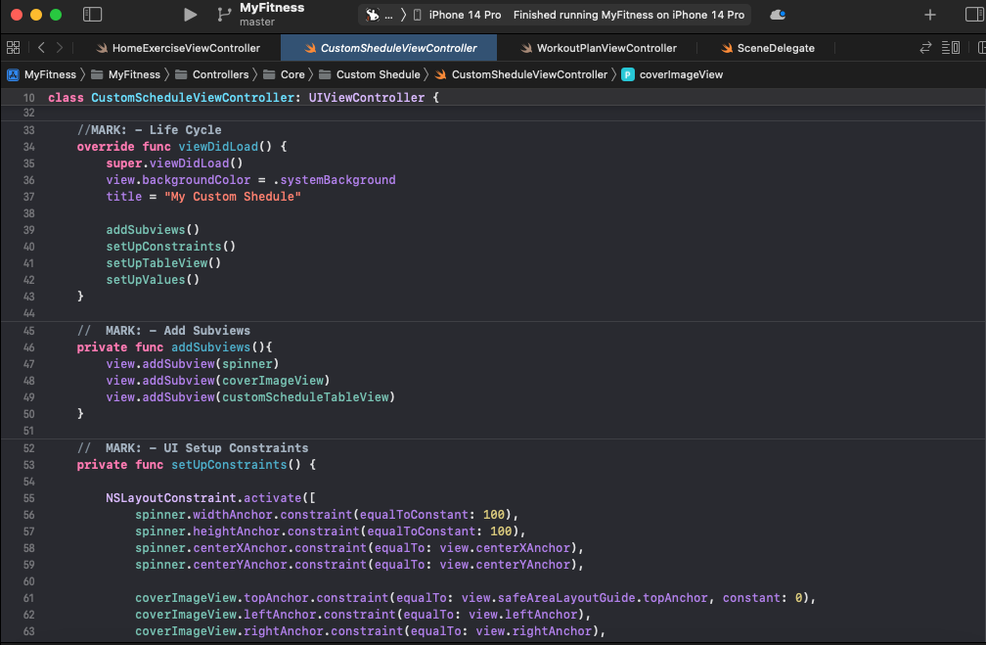
Using Best Practices
Manageable Code Structure When Design Interface
When designing the user interface, created a separate function as shown below and call the viewDidLoad() function. It made the code very easy to maintain.
Notes:
Manageable Code Structure When Design Interfaces
When designing the user interface, created a separate function as shown below and call the viewDidLoad() function. It made the code very easy to maintain.

Slide 22
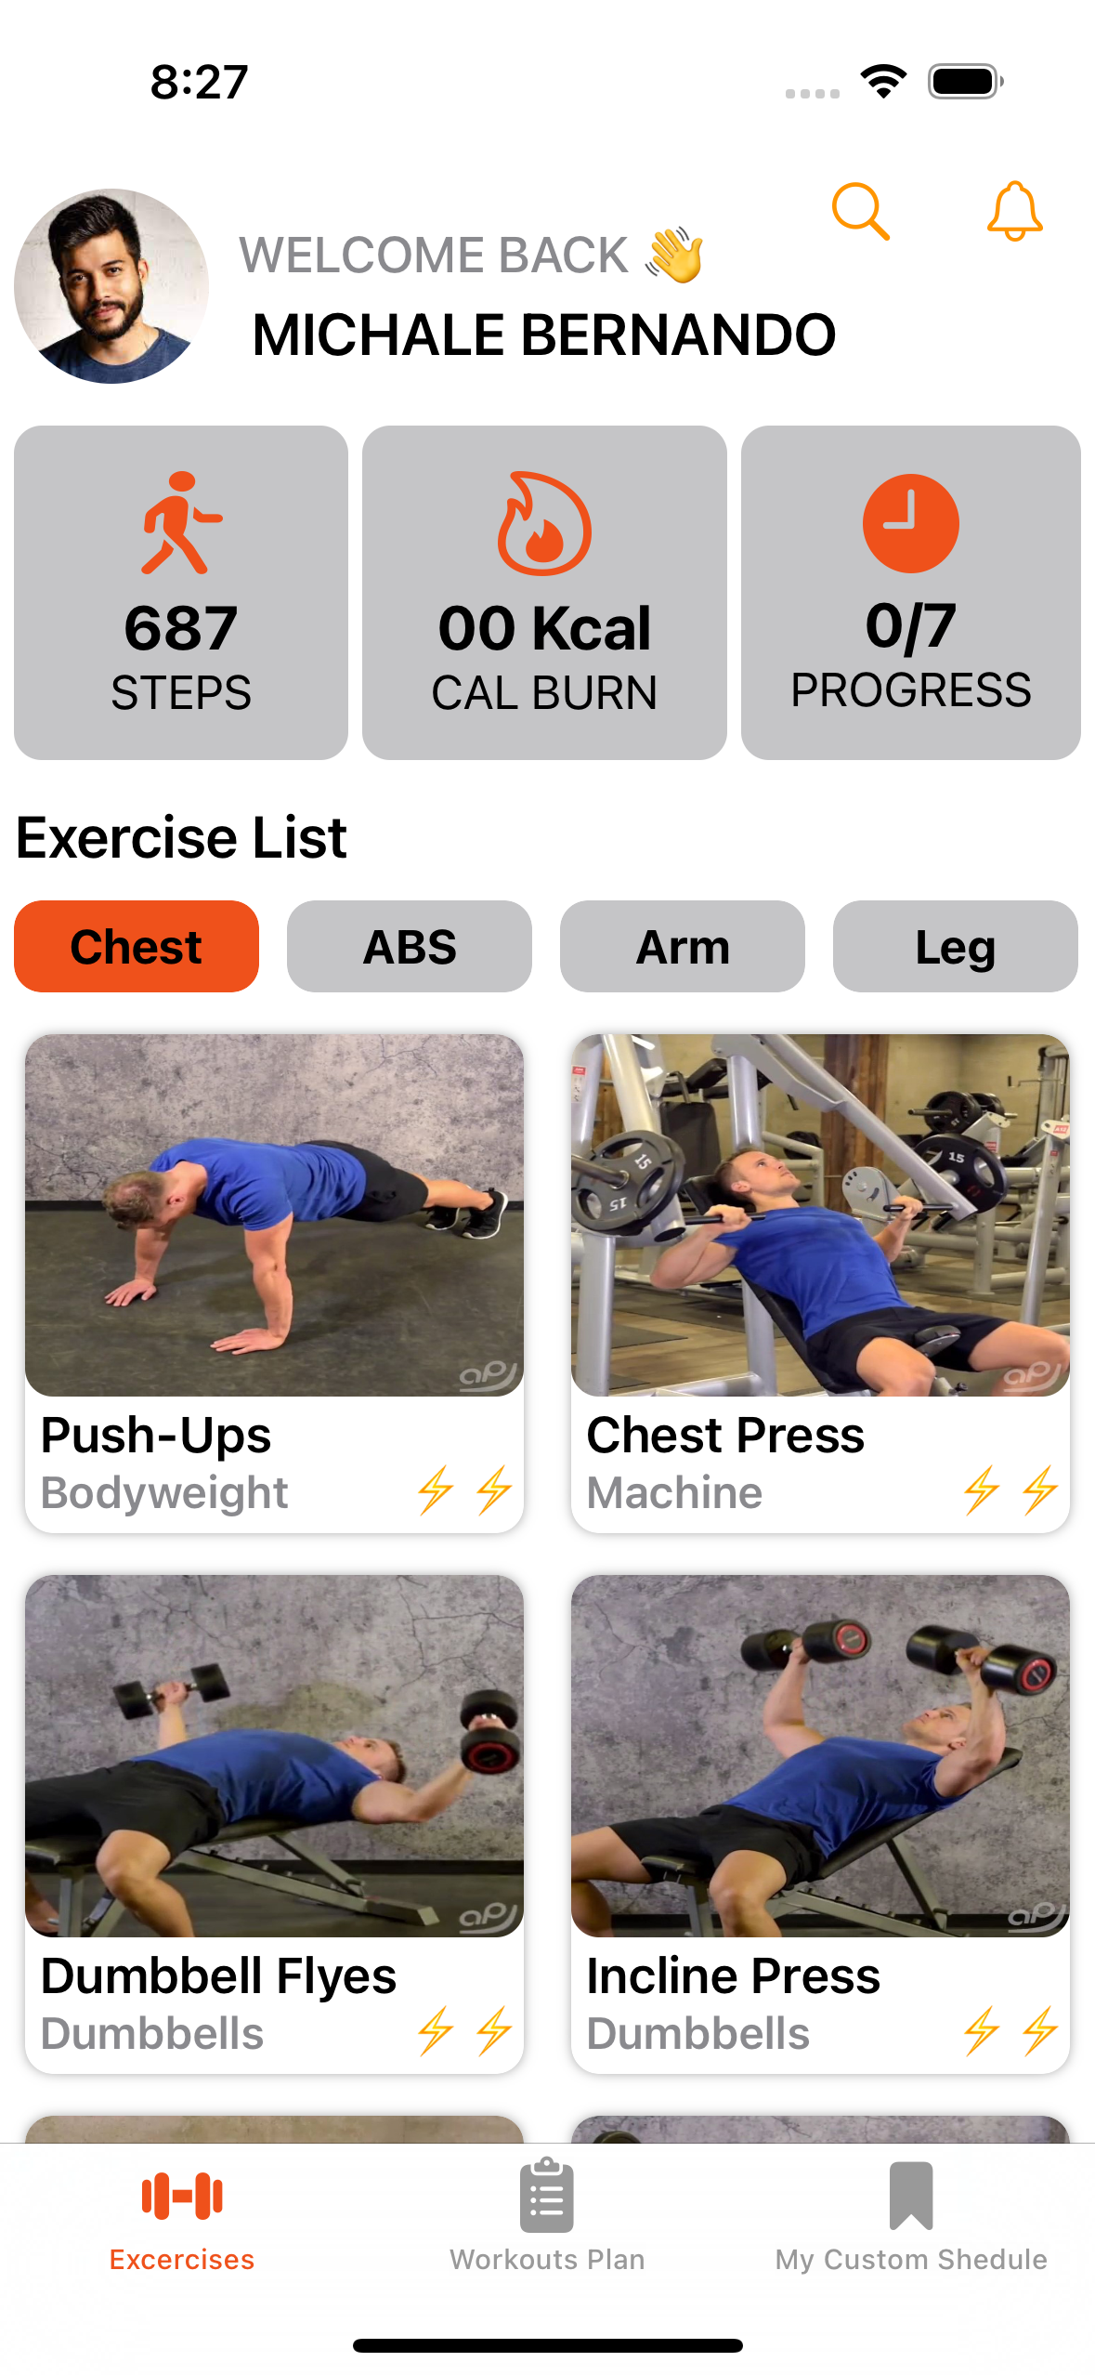
Using Best Practices
Support Dark Mode and Light Mode
In creating this software, the UI has been designed to support dark mode and lite mode
Notes:
Support Dark Theme and Light Theme
In creating this software, the UI has been designed to support dark mode and lite mode

Slide 23
Thank You
Notes:
Thank You Sir.

